Slide 1


Group Accident
The benefits of good hard work.®
Accidents can happen anytime, anywhere –
at home, at work, on the playground or on the road.
Benefits are paid for accidental injuries such as fractures, concussions, cuts, burns – any covered accidental injury that sends you to the emergency room, urgent care or a doctor’s office.
24 Hour, On and Off-Job Coverage
Premiums are paid with pre-tax dollars and benefits received are tax free.
An annual $50 Health Screening Benefit is included for each covered person.
Guaranteed Issue – no medical questions!
Coverage is portable if you change jobs or retire.

Slide 2

Group Accident
Here’s how it works….
The benefits of good hard work.®
While cleaning the gutters,
you fall from the ladder and break your leg.
Potential out-of-pocket expenses:
$100 Emergency room copay
$250 Deductible (copays do not count toward deductible)
$35 Specialist visit copay – orthopedic physician
$350 Specialist visit copay – occupational/physical therapy for 10 days
$735 Out-of-pocket
Potential benefits you may be eligible for with Colonial Life’s Group Accident Insurance:
$125 Accident Emergency Treatment
$150 Accident Follow-up Doctor Visit ($50 per visit, up to 3 per accident)
$100 Appliance (crutches)
$1,125 Fracture (broken leg)
$250 Occupational/Physical Therapy ($25/day for 10 days)
$30 X-Ray (for diagnosis of broken leg)
$1,780 of Benefits Paid Directly to You
in addition to other coverage you may have with other
insurance companies
The claims example above is based on a covered person aged 41 who receives a complete fracture of the leg and requires non-surgical repair. The policy has exclusions and limitations. Costs of treatment and benefit amounts may vary.

Slide 3
Group Critical Care with Cancer
A financial cushion when you need it most…
The benefits of good hard work.®
Coverage provides an employee- selected lump-sum benefit upon the diagnosis of each specified disease below:
Heart attack (Myocardial Infarction)
Stroke
Major Organ Failure
End stage renal failure (Kidney)
Permanent Paralysis due to a Covered Accident
Cancer
Carcinoma in Situ (25% of benefit)
Blindness
Coma
    Occupational Infectious HIV or Occupational Infectious Hepatitis B, C or D
Coronary Artery Bypass Surgery (25% of benefit)

Slide 4
Group Critical Care with Cancer
The benefits of good hard work.®
Also includes:
  $500/Month Cancer Treatment and Care Benefit, payable up to 12 months
  Annual $50 Health Screening Benefit per covered person
  One-time $500 Skin Cancer Benefit per covered person
Benefits are paid for subsequent and recurrent diagnosis of the same or a different critical illness.
There is NO LIFETIME MAXIMUM for policy benefits.
Premiums do NOT increase with age.
Face amounts up to $20,000 are Guarantee Issue!
*A 12-month pre-existing condition limitation does apply.

Slide 5
Wellness
…for Life
The benefits of good hard work.®
Colonial Life Health Screening Benefits
Colonial Life Group Accident and Group Critical Care plans include a $50 wellness benefit per covered person. If you have more than one policy, you will receive more than one benefit.
  2 Policies + 2 Covered Family Members + 1 Covered Test Each =
  4 Wellness Benefits ($50 x 4 = $200)
Wellness benefits are provided according to the calendar year.
Easily filed and Quickly Paid: No claim forms are needed for Health Screening claims. Simply call 1-800-325-4368 or visit, www.ColonialLife.com.

Slide 6
Whole Life prepared for your family’s future…
The benefits of good hard work.®
Life coverage to help provide protection for you and those who depend on you.
Dependable lifetime coverage with guaranteed cash value and guaranteed level premiums, that do not increase with age.
Coverage includes an additional Accidental Death benefit and an Accelerated Death benefit, if an insured is diagnosed with a terminal illness.
Benefits are paid, tax-free, directly to the beneficiary.
Coverage is portable, you can keep the coverage if you change jobs or retire.
Employee coverage up to $75,000 is Guarantee Issue.

Slide 7
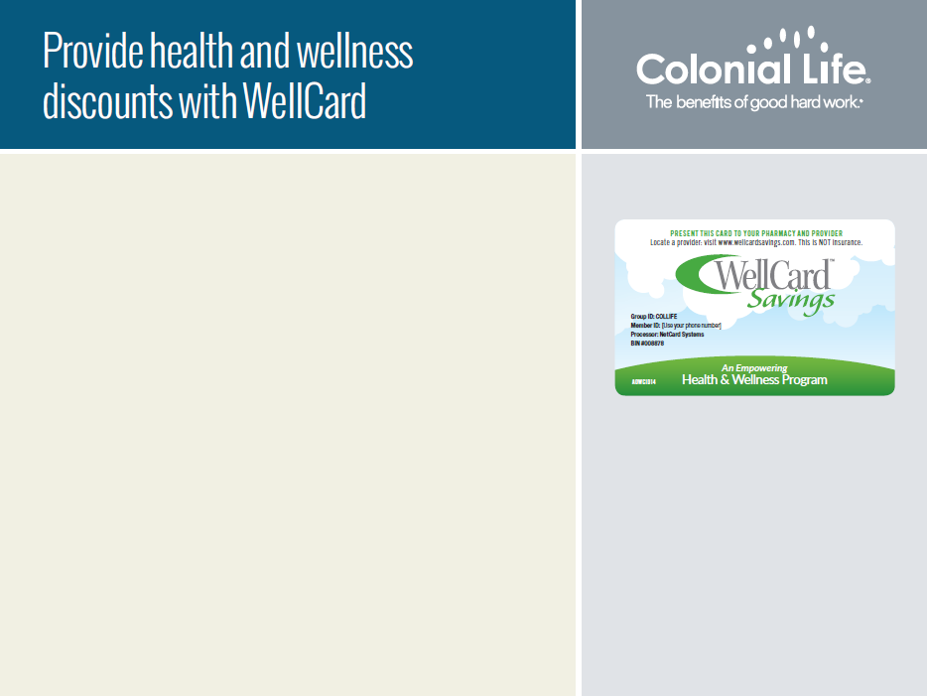
The WellCard program offers health and wellness products and services from brand-name vendors nationwide including:
Doctor’s office visits
Prescription drugs
Vision and hearing products and services
Medical bill help
Lab work, MRI scans and X-rays
Vitamins and daily living products
Cash rewards and entertainment benefits
For more information, visit
WellCardSavings.com
Plus, gain access to:
24/7 doctor consultations by phone or email
Medical bill assistance
Cash rewards and entertainment benefits

